Slide 1
Unit Testing Using Jasmine
1:15

Slide 2
AGENDA
What is Unit Testing
Behavior Driven Development
What is Jasmine
Installing Jasmine
How to write a test-case
Setup-Tear Down
Matchers
Asynchronous Testing
HTML Fixtures
Integerate SpecRunner in the build process
Question & Answers

Slide 3
Why to do Unit Testing

Slide 4
Common Problems
Steps to reproduce problems
PM : Build is going to happen in 10 mins
PM : Please commit your code fast
ID : Build is deployed, check the current functionality….. Cool !!! Working fine
Meanwhile someone else comes in to say, hey my page broke with the new build !!!!!
REGRESSION !!!!

Slide 5

BDD Comes for Rescue

Slide 6
Behavior Driven Development

Slide 7
Introduction
A brief History
Usually while developing any application every developer thinks of writing test-cases for any given functionality, but due to tight deadlines this task is usually not done.
The other reason of not working in a Test Driven Development manner is the requirements are usually not self explanatory, sometimes the requirements are written in a very vague manner, eg: please make a social networking site for me.
The reason for this usually that there is no proper bridge to communicate between non-techy and techy guys.
Thus a new language was invented which uses Given-When-Then, which is easily understood by every one.
We will look into how BDD is implemented in jasmine in next few slides.

Slide 8
What is Jasmine

Slide 9
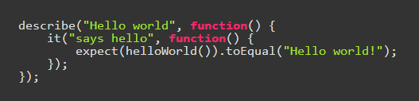
Introduction
About Jasmine
Jasmine is an automated testing framework for JavaScript.
Jasmine lets you make your program so robust, no matter what you throw it will perform the way you want it to perform.
Jasmine uses Behavior driven development approach.
Jasmine uses a specrunner to show the test results.
It does not depend on any other JavaScript frameworks.
It does not require a DOM
Jasmine test-case example :

Slide 10
Installing Jasmine

Slide 11
Installation Instructions
You can install jasmine standalone release which works well on any browser from the following link : http://jasmine.github.io/
You can install a node.js module of jasmine using the following command : npm install –g jasmine-node
You can find information to install jasmine on other environments from the following link : http://jasmine.github.io/2.0/introduction.html

Slide 12
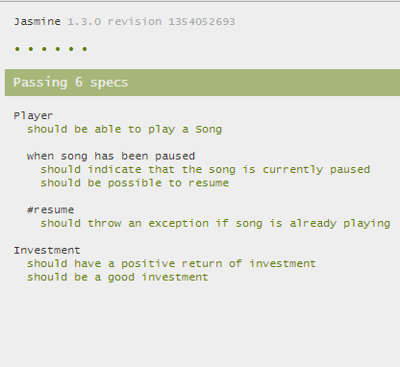
Preview of how a jasmine specRunner looks after installation.

Slide 13
How to write a test case

Slide 14
Criteria for a good test case
Test one method
Provide some set of arguments
Test the result from the method as expected.
It should not look inside the function to see what is going on, so that after refactoring also the same test unit is used precisely.
You should not use the method itself to dynamically generate a result, rather use static values to validate.
Eg : function add(x,y){return x + y;}
describe(“Math Operations”, function(){ it(“adds two numbers”, function(){ expect(add(3,2)).toEqual(5); }); });

Slide 15
Test suits
A test suite begins with a call to the global Jasmine function describe(param1, param2) with two parameters: a string and a function. The string is a name or title for a spec suite – usually what is being tested. The function is a block of code that implements the suite.
Example :
describe(“A suit”, function(){ it(“contains spec with an expectation”, function(){
expect(true).toBe(true);
}); });

Slide 16
Specs
Specs are defined by calling the global Jasmine function it(). A spec contains one or more expectations that test the state of the code. A spec with all true expectations is a passing spec. A spec with one or more false expectations is a failing spec. Example :
describe(“A suit”, function(){ it(“contains spec with an expectation”, function(){
expect(true).toBe(true);
}); });

Slide 17
Expectations
Expectations are built with the function expect which takes a value, called the actual. It is chained with a Matcher function, which takes the expected value.
Example :
describe(“A suit”, function(){ it(“contains spec with an expectation”, function(){
expect(true).toBe(true);
}); });

Slide 18
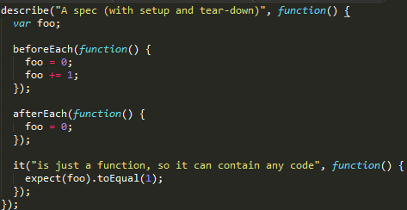
Setup & Teardown
In some cases we want to reinitialize or set some different values for every particular test case this can be done using the setup & teardown functions provided by Jasmine.
Example :

Slide 19
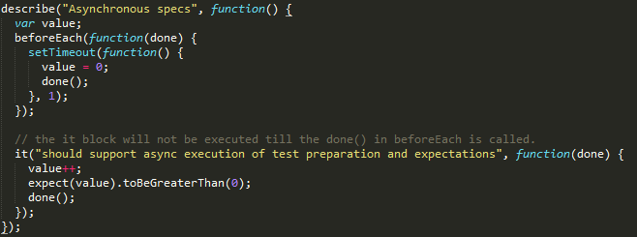
Asynchronous Support
Jasmine provides support for asynchronous support also by passing a param to beforeEach, afterEach or it functions.
The call to the next function in the sequence will not be done unless done() function is called in the current method.
This can be explained better using the eg below :
Example :

Slide 20
Jasmine-Jquery

Slide 21
What is Jasmine Jquery. + How to Install
Jasmine jquery is an extension to the Jasmine Unit Testing Framework.
It basically has built in support for jquery framework by providing custom matchers.
Plus, it also has an API for handling HTML, CSS and JSON fixtures in the specs.
You can use jasmine-jquery just by including the file https://raw.github.com/velesin/jasmine-jquery/master/lib/jasmine-jquery.js in the test runner file.

Slide 22
jQuery Matchers
Few of the jquery matchers are :
toBeChecked() : [only for tags that have checked attribute, eg : expect($(“input type=‘checkbox’ checked=‘checked’”)).tobeChecked()]
toExist() : [eg : expect($(“.loginButton_h”).toExist())]
You can find the complete list of functions over here : https://github.com/velesin/jasmine-jquery#jquery-matchers

Slide 23
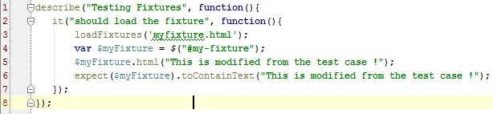
HTML Fixtures
This module allows to load the HTML content in the tests.
The HTML content is loaded inside the following container : [div id=“jasmine-fixtures”></div>]
Use Case :
We need to test the submit functionality, for that we need to simulate the click, and other changes in the DOM made due to this functionality. We need DOM element to implement this test.
Eg : This eg shows, basics of how to load a fixture and matches the content in it.

Slide 24
HTML Fixtures Important Notes
Where to put the .html files so as jasmine can load them : spec/javascripts/fixtures
You can configure this path:jasmine.getFixtures().fixturesPath = 'my/new/path';.
To make tests fully independent, fixtures container is automatically cleaned-up between tests, so you don't have to worry about left-overs from fixtures loaded in preceeding test. Also, fixtures are internally cached by the Fixture module, so you can load the same fixture file in several tests without penalty to your test suite's speed.
You can get more information about fixtures from the following URL : https://github.com/velesin/jasmine-jquery#html-fixtures

Slide 25
Integerate SpecRunner in the build process

Slide 26
Phantomjs Installation
Download the Zip file from: http://phantomjs.org/download.html
Unzip the folder : npm install –g grunt-contrib-jasmine
Copy the folder path and paste it at the end in the Path variable

Slide 27
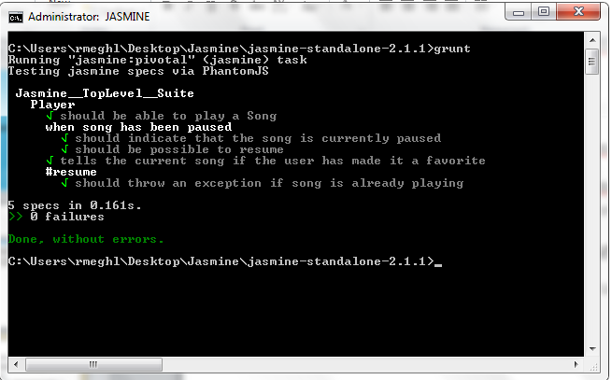
Grunt Installation
npm install –g grunt-cli
cd into your project directory and write the following commands :
npm init
npm install grunt-contrib-jasmine --save-dev
GruntFile.js
grunt

Slide 28
Question & Answers

